Slide 1
Tips and Tricks: Domino and JavaScript development masterclass
Engage 2018
#engageug
Paul Withers, Intec Systems Ltd
With thanks to John Jardin, Agilit-e

Slide 2

paul Withers
ICS Developer, Intec Systems
OpenNTF Board Member
IBM Lifetime Champion
@paulswithers
Notes Developer
XPages Developer
Java Developer
Microservices Developer

Slide 3

John Jardin
CTO, Agilit-e and Ukuvuma
IBM Champion (Cloud and ICS)
Guy who head bangs to Chainsmokers
@JohnJardinCodes
Integration & Cloud Architect
XPages Developer
DevOps Engineer
AI Programming

Slide 4
agenda
Introduction
Container Clustering
ReactJS
Domino as a datastore and API Gateway
What about scheduled tasks?
Microservices For Domino

Slide 5
introduction

Slide 6
This session?
IS NOT:
How to write your app using XYZ JavaScript framework and package it in the NSF
A first step in ultimately migrating away from a Notes and Domino ecosystem
IS:
About using Domino as the datastore and master API Gateway for a microservice architecture
About embracing new tools and technologies
About a shift in mind-set

Slide 7
Domino the monolith?
Domino for Directory Management
Domino TLS
Domino HTTP Server / Port 1352
NoSQL Data Store (NSF)
UI, MVC and Data (NSF)
Domino languages for workflow (LS / SSJS)
nupdate for indexing
Domino replication / clustering
Standard templates for auditing (log.nsf etc.)
Domino SMTP for mail routing

Slide 8
The reality
LDAP as an alternative for Directory Management
nginx / IBM HTTP Server on top of Domino
ODBC / JDBC / LEI / agents processing flat files
Web Services / agents to connect externally
UI and MVC in an XPages NSF, data in another NSF
Lotus Workflow for BPM
LEI / Notrix for scheduling
Third-party tools for better auditing (incl. OpenLog)
Export to data warehouse / NotesSQL for reporting
Mail routing via non-Domino SMTP server

Slide 9
Mutato nomine de te fabula narratur
Philosophically, there are similarities to a microservice architecture, just differences of scale
Custom workflow around ERP processes
Custom integration for multiple non-Domino systems
Configuration pulled from external systems

Slide 10
Change your thinking
Pros
Greater flexibility
Best of breed
Increased standardisation
Cons
Code for failure
Step outside comfort zone
More integration points

Slide 11
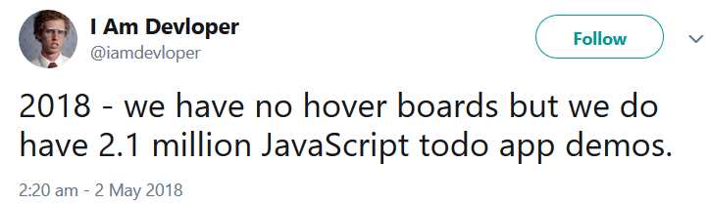
demo

Slide 12
Domino
Kubernetes Cluster
NSF Catalog
Agilit-e
NSF Store
NSF Store
NSF
Store
Node-RED
Web Socket Server
API Gateway
(OSGi Java Servlet)
React App
Istio

Slide 13
Container Clustering

Slide 14
A Different Approach
Don’t build 3rd party technologies into Domino
Have these technologies exist as a sidecar to a Domino environment
Each technology or service existing independently as a container
All communication occurs using APIs

Slide 15
A Different Approach Cont.
Example 1: ReactJS User Interface
Develop React UI using NodeJS and Webpack
In Domino, create API Endpoints for all relevant calls or use DAS
Deploy React App as a standalone container
Example 2: Web Socket Server
Create Web Socket Server using socket.io and NodeJS
In Domino, include socket.io for client-side communication
Create Web Socket events for all relevant communication
Deploy Web Socket Server as standalone container

Slide 16
Container Clustering
Cluster all relevant containers using Kubernetes
Run Kubernetes as a sidecar to your Domino environment
IBM Cloud Private provides enterprise-level container management using Kubernetes
Minikube can be used for development and testing environments (low availability)
Inject new services and containers into cluster as and when needed
Manage integration, security, testing and more with Istio

Slide 17
Benefits of Container Clustering
High availability
Seamless disaster recovery
Horizontal and vertical scaling
Continuous delivery
No downtime during updates and upgrades
CPU and Memory can be assigned and managed per container/container group

Slide 18
ReactJS

Slide 19
What is reactJS
A JavaScript library for building user interfaces
React is NOT a framework
React is the “V” of MVC (Model/View/Controller)
HTML is placed in JavaScript classes to create Web Components
This is similar to Custom Controls in XPages
React makes use of a Virtual DOM and Diffing

Slide 20
Platform Agnostic
React exists as a platform-agnostic solution
Webpack and Babel compile React to a single JS file
The ”create-react-app” module provides all required build tools
A typical React dev environment:
Atom/VS Code (Editor)
NodeJS
ExpressJS
Webpack

Slide 21
Domino as a datastore and api gateway

Slide 22
Domino rest options
DAS (Domino Access Services)
validation / visibility concerns – REST, not API Gateway
XAgents
viewState=“nostate”
allows caching in applicationScope
SmartNSF
written using Domain Specific Language
ODA Starter Servlet
develop in Eclipse, local Domino server
development and deployment without Domino Designer
allows powerful caching for better performance
Newsflash: Domino10 brings NodeJS, dominoDB, LoopBack, (Node-RED)

Slide 23
REST VS API
API-first approach means
Greater control
More planning up-front
Longer initial development lifecycle
Increased portability
Better separation between database and interface
Easier extensibility into other systems
Code for failure and “bad data” – ON BOTH SIDES
Missing parameters
Invalid enums

Slide 24
REST VS API CONT.
Security considerations
How to restrict access to apps: API key, OAuth?
Use header / query params correctly
Secure e.g. scheduled endpoints differently
Additional logging of transactions?
Be careful what you expose
Should your “status” field be editable
Or just set via workflow methods

Slide 25
REST PERFORMANCE
REST = stateless, servlet = stateful
Cache with…
ConcurrentHashMap (think applicationScope)
Google Guava Caches (better management)
Cache Server (e.g. memcache, Ehcache)

Slide 26
documentation
Swagger / Open API Specification is standard
Swagger Editor online, local node.js app or Docker
OpenAPI 3.0 released July 2017
Samples not yet updated
Swagger 2.0 has many examples
Swagger Hub or tools like Mermade will convert (between the 2)
Swagger UI allows testing against actual server
Swagger mock server can be created for UI dev

Slide 27
Creating a swagger definition
Write as YAML or JSON
YAML – no quotes around strings, no commas, no curly braces
operationIds can be added
If used, required on all for that path
Use enums for options
OpenAPI 3.0 allows examples, but clarify and add value
“Framework for good documentation”, does not guarantee good documentation

Slide 28
testing
Various REST service tools are available
Postman (Electron desktop app)
RestClient plugin for Firefox
JUST USE NODE-RED!

Slide 29
http Request Types
GET – Read data (No body data allowed)
POST – Submit data (Read/Write)
PUT – Replacing entire document data
PATCH – Minor update to existing data
PATCH not enabled by default on Domino
DELETE – Deleting Records (No body data allowed)

Slide 30
HTTP status codes
1xx – Received and understood, stand by…
2xx – Received, understood and accepted
3xx – Redirecting
4xx – You did something wrong!
5xx – We did something wrong!
See Wikipedia

Slide 31
http status codes CONT.
200 – OK
202 – Accepted for processing
302 – URL found but server is redirecting
400 – Bad request
401 – Unauthorised
403 – Forbidden
404 – Not found
405 – Method not allowed
500 – Internal server error

Slide 32
What about scheduled tasks?

Slide 33
Scheduled tasks
Scheduled Agents
NSF only, language constraints (LS or Painful Java)
DOTS
Server only, deployment constraints
How about a different approach?

Slide 34
API + node-red = flexibility
API
XAgent / SmartNSF / or REST endpoint
Use Xots for background processing
Node-RED – Installable alongside Domino with NodeJS
Scheduling of flows that includes Web APIs
Other schedulers would work, as long as they can call a Web API

Slide 35
Node-red
An integration tool for wiring together APIs and online services
Available on IBM Cloud, local node.js app or Docker
Note: Docker containers not aware of host’s “localhost” or other containers
Schedule tasks via Inject node (or Big Timer)
Additional nodes for e.g. Watson Services, Connections
Basic authentication can be set
Flows can be imported / exported as JSON

Slide 36
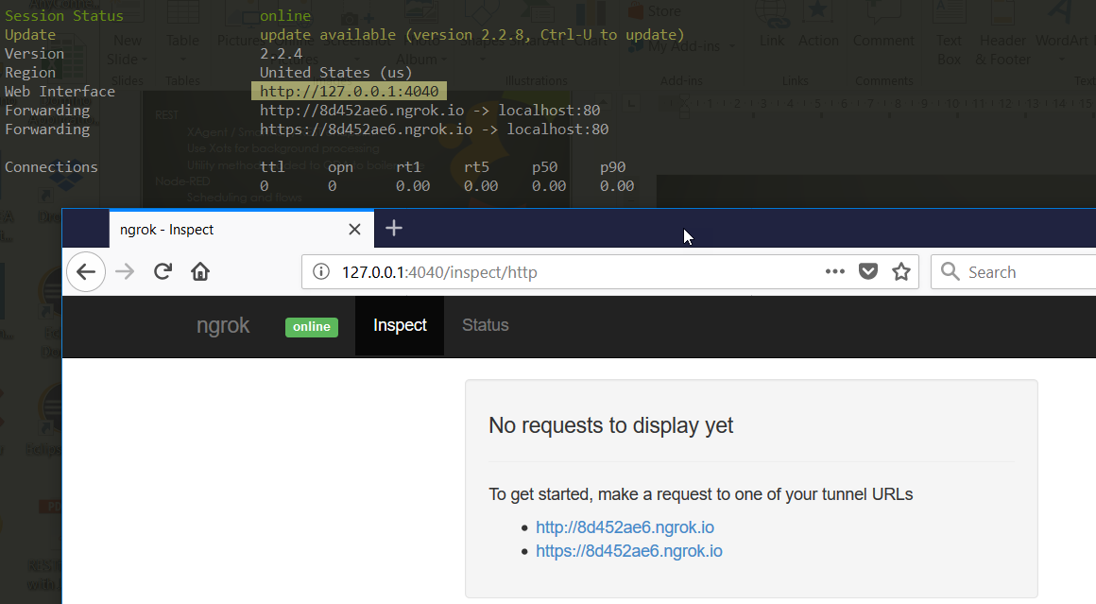
Integrating private / public
“Private” needs to be made “public”
ngrok provides secure tunnels
cmder is a good console emulator for Windows

Slide 37
Microservices For Domino

Slide 38
Microservice Patterns
Micro-Functions
Breakdown functions into re-usable/modular code blocks
Each function should do one thing and do it well
Simplify and optimize the code within each function
A function shouldn’t contain more than 80-100 lines of code
Develop ”Pure Functions” whenever possible
Easier to test for “code coverage”

Slide 39
Microservice Patterns Cont.
Micro-Services
Define which micro-functions can become services to 3rd party platforms and applications
Create API Endpoints that trigger your micro- functions
Ensure a strong security layer for 3rd parties to interface with before triggering your services

Slide 40
Future ideas
Add JUnit tests
Add Node-RED test flows
Extend Watson Workspace with Raspberry Pi to create ToDo via speech
Split app to show one ToDo store at a time
Create scheduler to post offline-created ToDos
Post ToDo from IoT flow if above a threshold
Create Node-RED dashboards for ToDos
Update React app layout to fit nicely on mobile

Slide 41
Thank You and questions?
Paul Withers
Intec Systems Ltd
http://www.intec.co.uk/blog
@paulswithers
http://watsonwork.me/pwithers@intec.co.uk
John Jardin
Agilit-e
Website: https://www.agilite.io
Blog: http://bleedingcode.com
Twitter: @JohnJardinCodes

